Slide 1

Contemporary Accounting Research (2018)
Do Analysts Gain an Informational Advantage by Visiting
Listed Companies?
BING HAN
University of Toronto and Southwestern University of Finance and Economics
DONGMIN KONG
Zhongnan University of Economics and Law and
Huazhong University of Science and Technology
SHASHA LIU
Jinan University
Reporter：蒋安璇

Slide 2
Section 1
Introduction
Research Motivation
Analysts play a crucial role in information acquisition and dissemination in the financial markets.
This paper investigates a specific channel through which analysts might acquire information and aims to quantify the benefit they receive.
It focuses on company visits by analysts working at brokerage firms.
Knowledge of the economic consequences of company visits remains limited.

Slide 3
Section 1
Introduction
Research Conclusion
This paper investigates whether company visits provide analysts with an informational advantage.
We find that company visits significantly enhance the accuracy of the analysts’ earnings forecasts for those companies.
The benefit from company visits is more pronounced for companies that are more neglected or less accessible and for brokerage firms that face less pressure for optimistic forecasts from buy-side clients.
Our results are robust and remain significant after controlling for endogeneity and selection bias.
Overall, our findings show that private interactions with company management provide analysts with an informational advantage and suggest that company visits facilitate the mosaic approach to information acquisition.

Slide 4
Section 1
Introduction
Contribution
We provide direct evidence that company visits improve analysts’ earnings forecast accuracy, by clearly identifying private interactions between companies and analysts and matching them with analysts’ subsequent forecasts.
Our results suggest that visiting a company is an important way for analysts to obtain information that increases accuracy of their forecasts.
Our findings expand our understanding of the determinants of analysts’ forecast accuracy.
Our results add to the literature on buy-side business pressures and analyst bias (Firth et al. 2013; Gu et al. 2013) by demonstrating that buy-side pressures reduce analysts’ ability to use the information they obtain via company visits.

Slide 5
Section 2
Data and variables
Data
We obtain a unique database from the SZSE that includes detailed information on visits to the company by all interested parties, including individual investors, fund managers, and analysts from brokerage firms. Since 2006, the SZSE has required listed companies to disclose such visits.
Our sample period begins in 2007, when the visiting records of listed companies became available.
CSMAR\Wind
We focus on brokerages’ visits of listed companies and examine their effects on the accuracy of the subsequent earnings forecasts issued by the visiting brokerage firms.

Slide 6
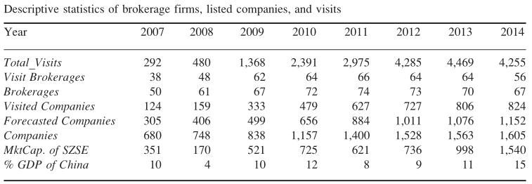
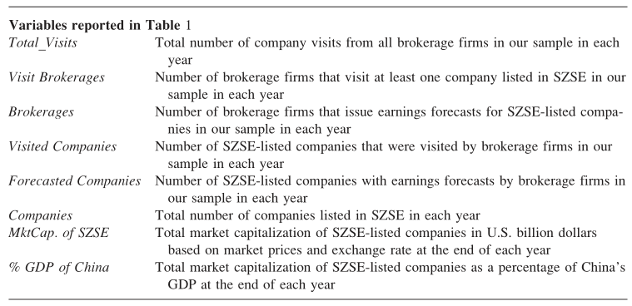
Section 2
Data and variables
Summary statistics

Slide 7
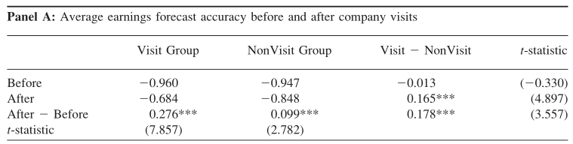
Section 2
Data and variables
Summary statistics
An observation in year t belongs to the Visit Group if a brokerage firm visited a company before making an earnings forecast for that company prior to its year t earnings announcement. Otherwise, it is classified under the NonVisit Group.
The average earnings forecast accuracy in each group in both year t-1 (the row labeled “Before”) and t (the row labeled “After”).
Analysts derive economic benefits from company visits in terms of more accurate earnings forecasts.

Slide 8
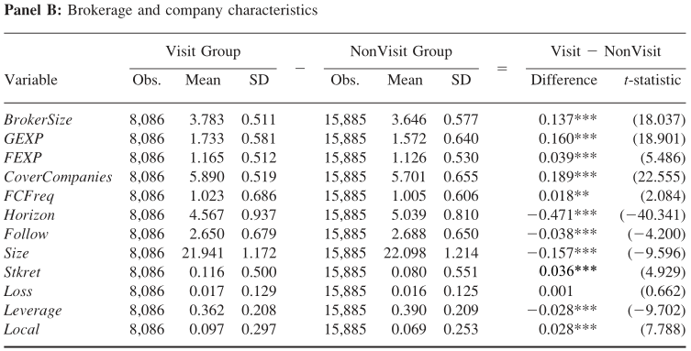
Section 2
Data and variables
Summary statistics

Slide 9
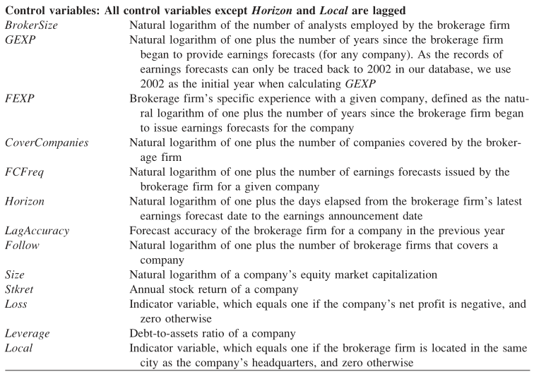
Section 2
Data and variables
Summary statistics

Slide 10
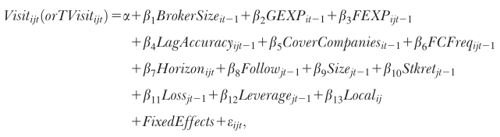
Section 2
Data and variables
Determinants of company visits
We further explore the factors that affect brokerage firms’ decisions to visit companies using a probit model, with the dummy variable Visit as the dependent variable.
For robustness, we also estimate an ordered probit model with TVisit (defined as the number of visits by a brokerage firm to a company in a given year) as the dependent variable.
Analyst characteristics:brokerage size,analysts’ abilities,experiences,number of forecasts by a brokerage firm for a given company,previous forecast accuracy
Company:firm size,stock performance, financial performance, leverage ratio, analyst coverage, and a dummy for local company

Slide 11
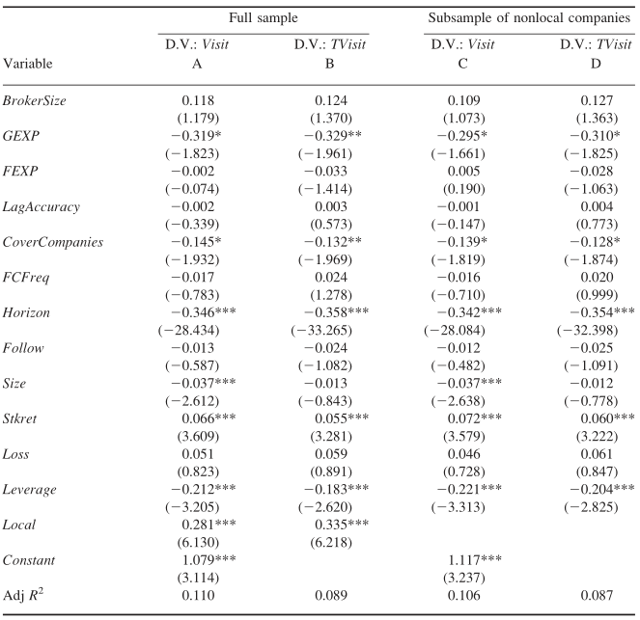
Section 2
Data and variables
Determinants of company visits
Overall, we find a link between some company characteristics and the probability of being visited by brokerage firms, whereas analyst/brokerage characteristics are generally unimportant in the company-visit decision.

Slide 12
Section 3
Empirical results
Do company visits enhance earnings forecast accuracy?
Baseline results
dependent variable Accuracy_{ijt} is the accuracy of brokerage firm i’s last earnings forecast for company j in year t before its earnings announcement.
key independent variable Visit_{ijt} denotes whether brokerage firm i visited company j in year t before issuing the earnings forecast whose accuracy is being measured in the dependent variable.
We control for brokerage size,analyst ability and the number of companies covered by a brokerage firm, forecast horizon,company’s analyst coverage,company’s profitability,company market capitalization，company stock performance, company leverage ratios, and an indicator variable to control for the potential informational advantage of local analysts.

Slide 13
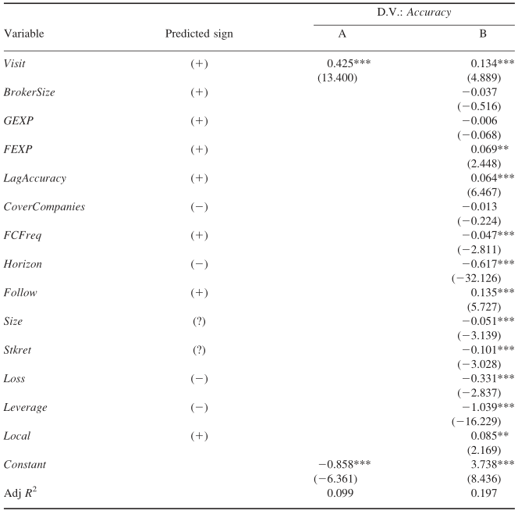
Section 3
Empirical results
Do company visits enhance
earnings forecast accuracy?
Baseline results
brokerage firms that visit companies are more accurate compared to observations without company visits.

Slide 14

Section 3
Empirical results
Do company visits enhance earnings forecast accuracy?
Endogeneity
The decision to visit a firm may be influenced by factors that also relate to analysts’ forecast accuracy
IV estimation: two-stage least squares regression.
Exogenous variable:extreme weather conditions (Weather) in the city of the company headquarters, as an instrument for company visits
We define a day as an extreme weather day (ExtrmDay=1) if the lowest temperature falls below -10℃, if the highest temperature reaches above 38℃, or if rainfall is greater than 50 mm on that day.
Weather is defined as the percentage of days in a given year with extreme weather conditions in the city where the company’s headquarters is located:
The average value of Weather is 10.0 percent with a standard deviation of 12.1 percent and a maximum value of 37.5 percent in our sample period.

Slide 15

Section 3
Empirical results
Do company visits enhance earnings forecast accuracy?
Endogeneity
DID and PSM:to address a potential selection bias in company-visit decisions.
We first estimate the probit model in equation (1) for the whole sample.
The predicted value of the probit model gives us the propensity score for a company to be visited.
We use the propensity score to match an observation from the Visit Group with an observation from the NonVisit Group.
The PSM subsample consists of the treated group plus the matched group.

Slide 16
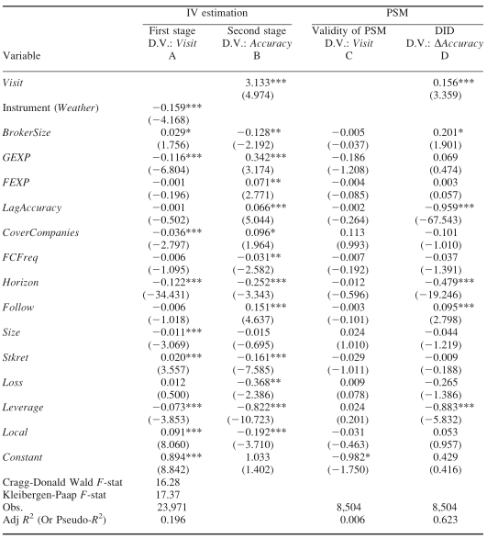
Section 3
Empirical results
Do company visits enhance
earnings forecast accuracy?
Endogeneity
The 2SLS results from the instrumental variable approach establish that face-to-face interactions with company managers during company visits appear to provide an informational advantage to visiting analysts and enhance their forecast accuracy.
After controlling for the potential selection bias in the visit decision, we still find that company visits by analysts enhance their forecast accuracy.

Slide 17
Section 3
Empirical results
Cross-sectional differences in the improvements of forecast accuracy
Do analysts benefit more from visiting hard-to-visit companies?
We expect the relationship between analysts’ company visits and their forecast accuracy to be stronger for companies with low accessibility.
For companies that are hard to visit, measured in terms of traveling convenience, we expect the impact of those visits to be larger than other companies. As more analysts can visit companies that are conveniently located, the usefulness of the private information obtained via company visits is lower.
Flight_{ij} is a proxy for traveling convenience, measured by the number of direct flights between the headquarter city of company j and that of the brokerage firm i.
We exclude earnings forecasts made by local analysts.
We do not want the informational advantage of local analysts to contaminate our test.

Slide 18
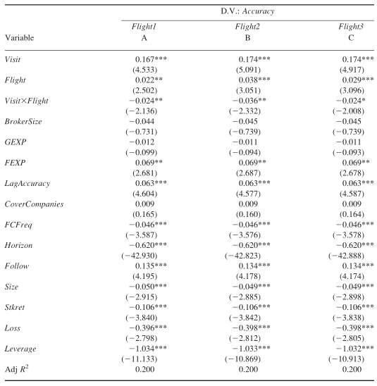
Section 3
Empirical results
Cross-sectional differences in the improvements of forecast accuracy
Do analysts benefit more from visiting
hard-to-visit companies?
Flight1:Natural logarithm of one plus the number of direct flights between the headquarter city of the company and that of the brokerage firm
Flight2:Natural logarithm of one plus the average number of direct flights from the headquarter cities of all brokerage firms to the company’s headquarters
Flight3:Natural logarithm of one plus the average number of direct flights from Beijing,Shanghai, Guangzhou, and Shenzhen to the company’s headquarters

Slide 19
Section 3
Empirical results
Cross-sectional differences in the improvements of forecast accuracy
Do analysts benefit more from visiting neglected companies?
We expect a larger improvement in forecast accuracy after visiting a relatively neglected company.
We contend that it is more difficult to gain unique information from a company that receives more media and analyst attention.
Media Coverage:defined as the natural logarithm of one plus the number of articles on the company that appear in a set of newspapers, including the China Securities Journal, Shanghai Securities News, and Securities Times, where the China Security Regulatory Commission (CSRC) requires listed companies to disclose necessary information.
Follow:the natural logarithm of one plus the number of analysts making earnings forecasts for the company in a given year, based on analyst coverage data from the CSMAR database.

Slide 20
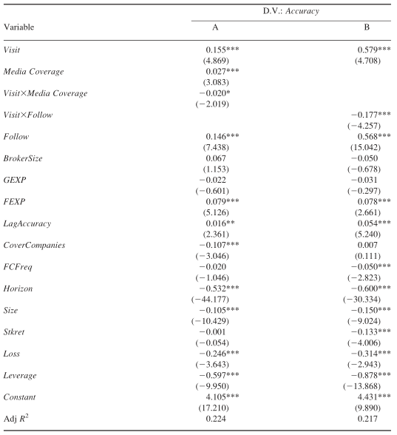
Section 3
Empirical results
Cross-sectional differences in the improvements of forecast accuracy
Do analysts benefit more from visiting
neglected companies?
Although the average analyst forecast accuracy is lower for companies that are under the radar, analysts who visited such companies can improve their forecast accuracy more than if they visited companies that are already receiving more market attention.

Slide 21

Section 3
Empirical results
Cross-sectional differences in the improvements of forecast accuracy
The effects of buy-side business pressures
Conflicts of interest may interfere with analysts’ ability to take advantage of the information advantage conferred by company visits. ——buyside business pressure
Brokerage firms’ institutional clients (e.g., mutual funds) can pressure analysts to issue optimistically biased ratings on the stocks in their portfolios by allocating (or threatening the withdrawal of) trading commissions to the brokerage firms employing the analysts
BuySide_{ijt}:a proxy for the pressure felt by brokerage firm i due to buy-side commission fees related to a given company j

Slide 22
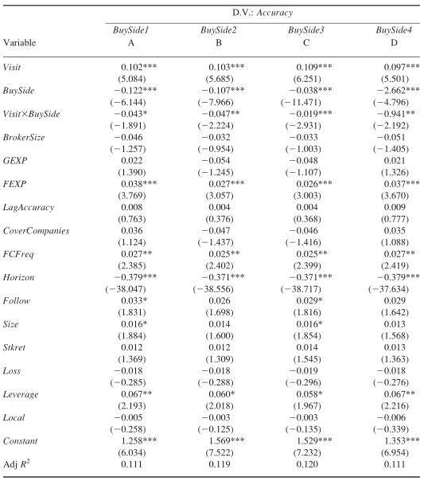
Section 3
Empirical results
Cross-sectional differences in the improvements of forecast accuracy
The effects of buy-side business pressures
BuySide1:Indicator variable that equals one if the company’s stock was held as a top-10 position by at least one of the mutual fund clients of the brokerage firm in the previous quarter, and zero otherwise
BuySide2:Indicator variable that equals one if the company’s stock was held in a top-10 position by at least one of the brokerage firm’s important mutual fund clients in the previous quarter, and zero otherwise. A mutual fund is considered an important client if the commission paid to the brokerage firm is above the median level of commission paid by all of its mutual fund clients or more than 5 percent of the total commissions that the brokerage firm receives
BuySide3:Natural logarithm of the total commissions received from clients who held the company’s stock in the previous quarter
BuySide4:Total value of the company’s stock held by mutual fund clients divided by their total assets under management in the previous quarter

Slide 23
Section 3
Empirical results
Additional results and robustness checks
Analyst preparations for company visits
In the preparation stage, analysts may conduct research and acquire information that improves their understanding of the company, which is then refined and validated during the visit. Thus, preparations may contribute to visiting analysts’ improved accuracy.
We hand-collect and categorize the questions analysts ask during the company visits. Specifically, we categorize analyst questions into nine types and classify some as “deep”.
We argue that analysts who ask a broader array of questions or deeper questions are more likely to have prepared for the visits than analysts who ask fewer or routine questions.
We partition our sample based on the number and types of questions into four subsamples: visits asking one type of question; visits asking at least two types of questions;visits asking simple questions, and visits asking deep questions.

Slide 24
Section 3
Empirical results
Additional results and robustness checks
Analyst preparations for company visits
Type 1 concerns a company’s routine operations, such as company fundamentals, financial condition, future operating strategies, and industry or macroeconomic conditions.
Type 2 concerns a company’s payout policy, general corporate governance, shareholders’ meeting plans, and annual report disclosure dates.
Type 3 concerns a company’s stock performance.
Type 4 concerns a company’s stock issuances, stock ownership transfers, share-split reforms, nontradable share issues, and ownership changes of control shareholders.
Type 5 concerns asset operations, such as asset restructuring, asset replacements, mergers, and acquisitions.
Type 6 concerns company debt, such as restructurings, replacements, and write-offs.
Type7 concerns detailed issues of corporate governance, such as the use of capital, related-party transactions, lawsuits, and company guarantees.
Type 8 concerns top management salaries, stock option incentive plans, and managementturnover.
Type 9 concerns the details of a company’s performance that require knowledge of company performance in both the current and previous years. It includes discrepancies in the annual report or company performance data and inquiries about the effects of specific events on company performance.

Slide 25
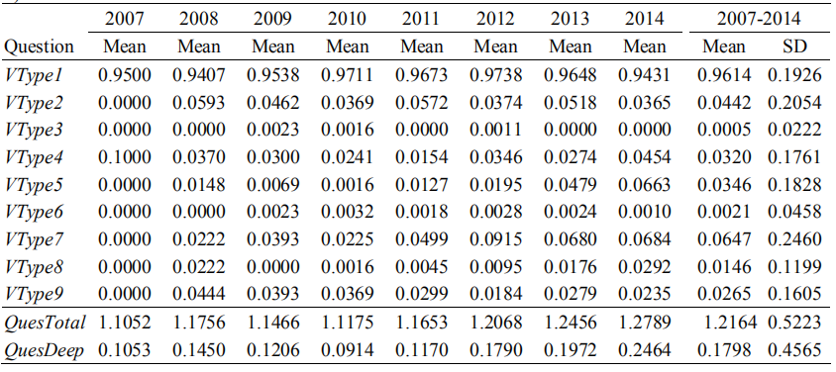
Section 3
Empirical results
Additional results and robustness checks
Analyst preparations for company visits

Slide 26
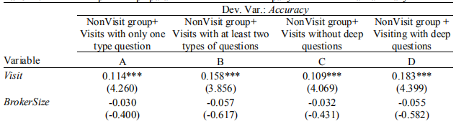
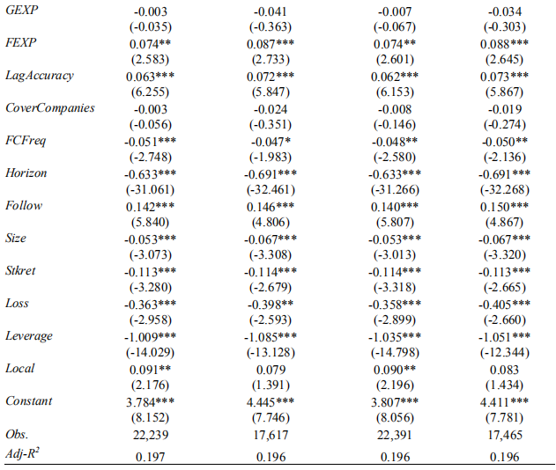
Section 3
Empirical results
Additional results and robustness checks
Analyst preparations for company visits
when analysts visit companies, they provide more
accurate forecasts than those without visits even after controlling for their preparations.

Slide 27
Section 3
Empirical results
Additional results and robustness checks
Selective disclosure by managers
To address the concern that the informational advantage gained from company visits may be the result of material selective disclosure by company managers during the visits.
We repeat the baseline regression after dropping all visiting records within one month of the earnings announcements.
The likelihood of selective disclosure during company visits that occurred months before earnings announcements is low, because managers could not observe precise signals about earnings far in advance.

Slide 28
Section 3
Empirical results
Additional results and robustness checks
Initial coverage
To control for the potential effect of analyst skill on the visiting decision and earnings forecast, we have included the lagged forecast accuracy (from the previous year) as an independent variable and excluded observations of the first earnings forecast on a company by a brokerage firm.

Slide 29
Section 3
Empirical results
Additional results and robustness checks
Earnings forecasts by an individual analyst versus a team of analysts
A natural question is whether the analyst from a brokerage firm visiting a company is the same person issuing earnings forecast for that company.
In the case that a team of analysts covers a company, we expect that the visiting analyst can convey the information obtained via the company visit to the rest of the team
We conjecture that a brokerage firm’s visit to a company enhances its analysts’ forecasting performance for that company, regardless of how many analysts are employed by the brokerage firm to cover the company and which analyst visited the company.
The first (second) group contains the earnings forecasts of brokerage firms that employ only one (more than one) analyst to cover a company in a given year.

Slide 30
Section 3
Empirical results
Additional results and robustness checks
Alternative measures of forecast accuracy
Accuracy2:defined as the forecast accuracy used in the main tests minus the average earnings forecast accuracy over all brokerages for the same company in the same year.
Accuracy3:We adopt another widely used accuracy measurewhich is similar to Accuracy but uses the actual EPS instead of the stock price as the denominator.

Slide 31
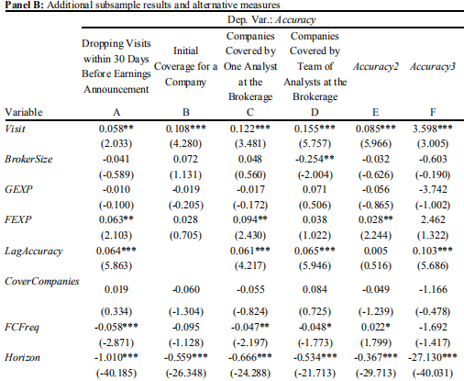
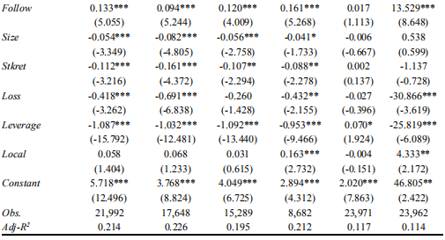
Section 3
Empirical results
Additional results and robustness checks

Slide 32
Section 4
Conclusion
First, our results are based on Chinese data. Given the significant differences between emerging markets and developed markets,it is important to evaluate the generalization of our results in future research.
Second, our paper focuses on the informational advantage of company visits to the sell-side analysts employed by the brokerage firms. Future studies can gain a more complete understanding of the informational advantage of private access to company management by including other entities (e.g., institutional investors and buy-side analysts) who can also visit the companies.

Slide 33
THANK YOU!

